Slide 1







Ride-sharing service Data
Cellula

Slide 2



Introduction to Data
To explore the ride-sharing service data and uncover insights related to fare, traffic, weather, and time-based trends.
500,000+ records of ride-sharing trips
Key columns: User ID, Driver Name, Fare Amount, Weather, Traffic Condition, Distance, and time-related features like year, month, weekday.
Back to Agenda Page

Slide 3
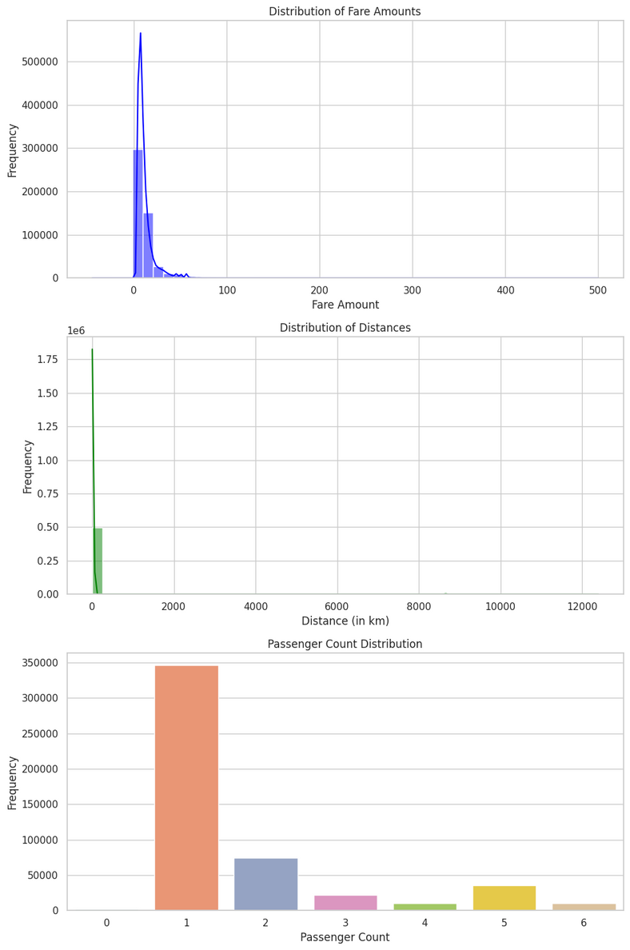


Understanding the Fare Distribution
Most fares cluster between $6 and $20, with a few outliers at higher amounts.
The majority of trips are short-distance rides, reflected in lower fares.
The fare distribution shows that the service is affordable for most customers, with rare occurrences of high fares.
Back to Agenda Page

Slide 4

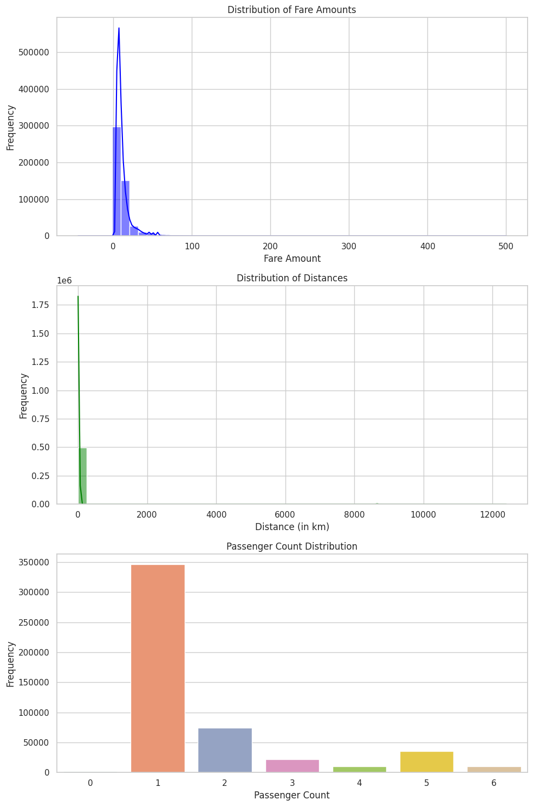
Passengers Count
Back to Agenda Page

Slide 5
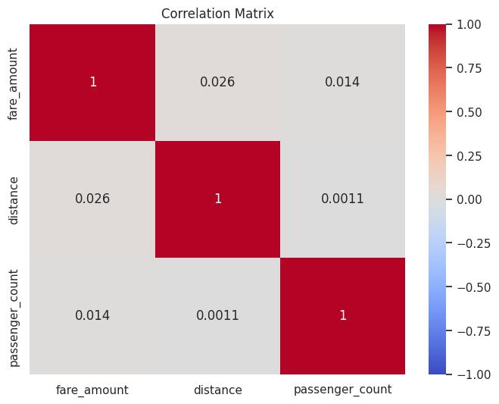


Relationship Between Distance and Fare
Positive correlation
Longer distances generally result in higher fares.
outliers
long trips have low fares, possibly due to promotions or special discounts.
Key Role
Distance plays a key role in determining the fare, but other factors like traffic and demand likely impact the pricing too.
Back to Agenda Page

Slide 6

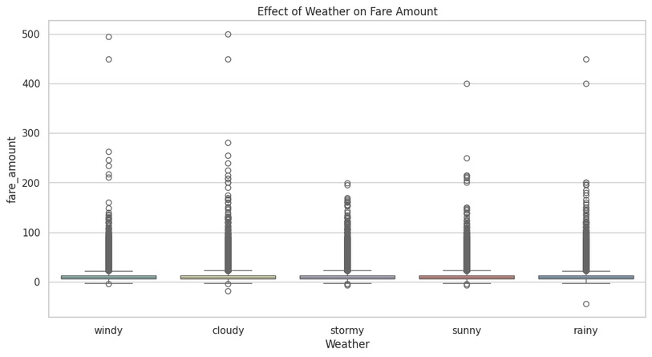
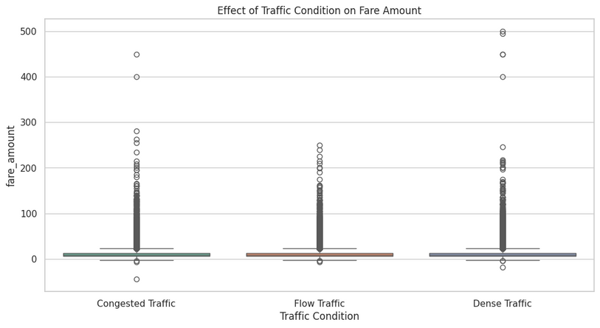

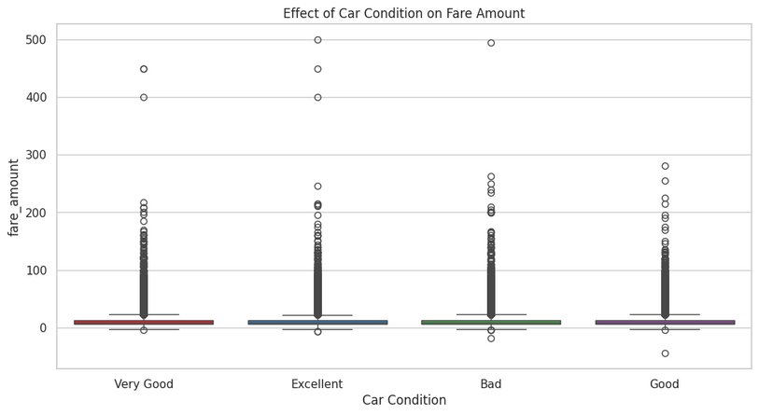

Impact of Traffic and Weather on Fares
r
Back to Agenda Page

Slide 7

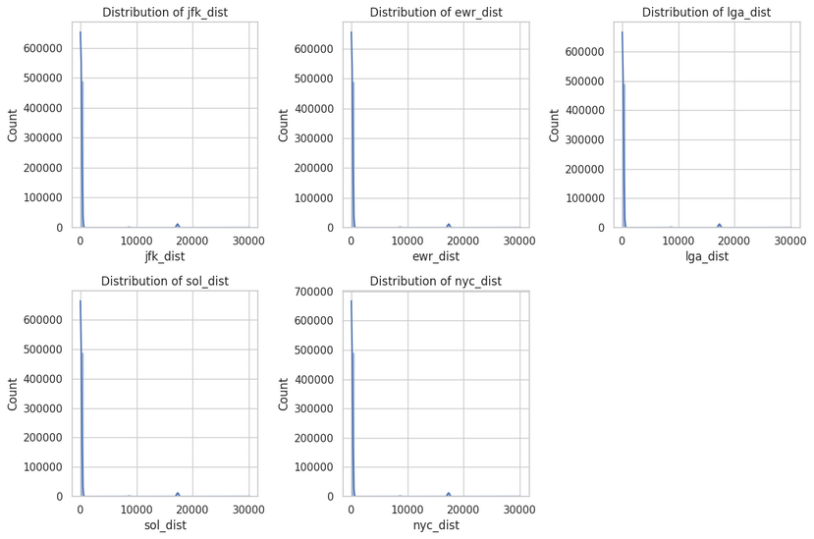
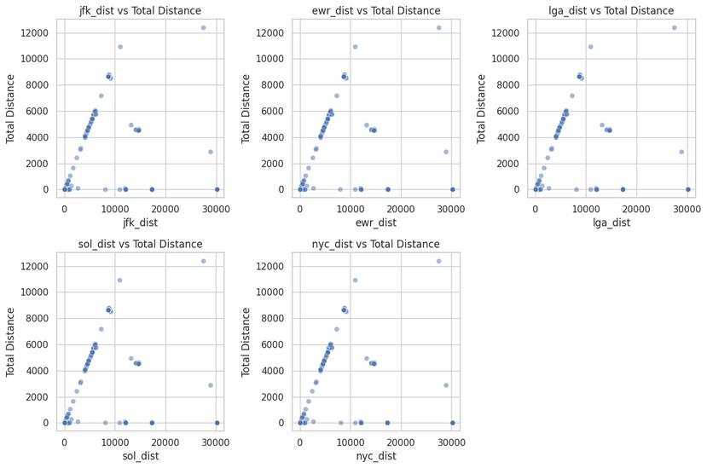
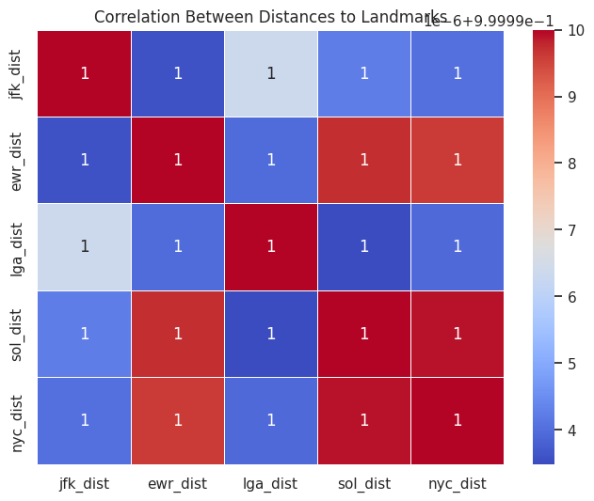

Distance to Landmarks
Back to Agenda Page

Slide 8

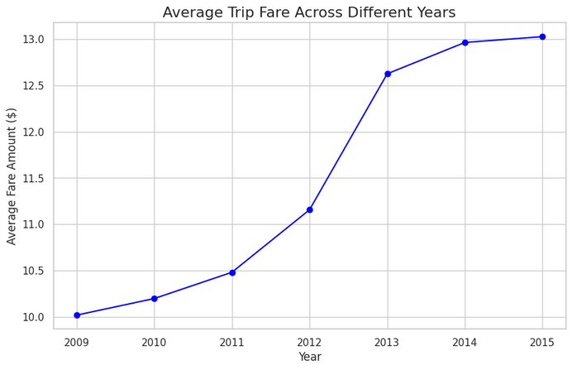
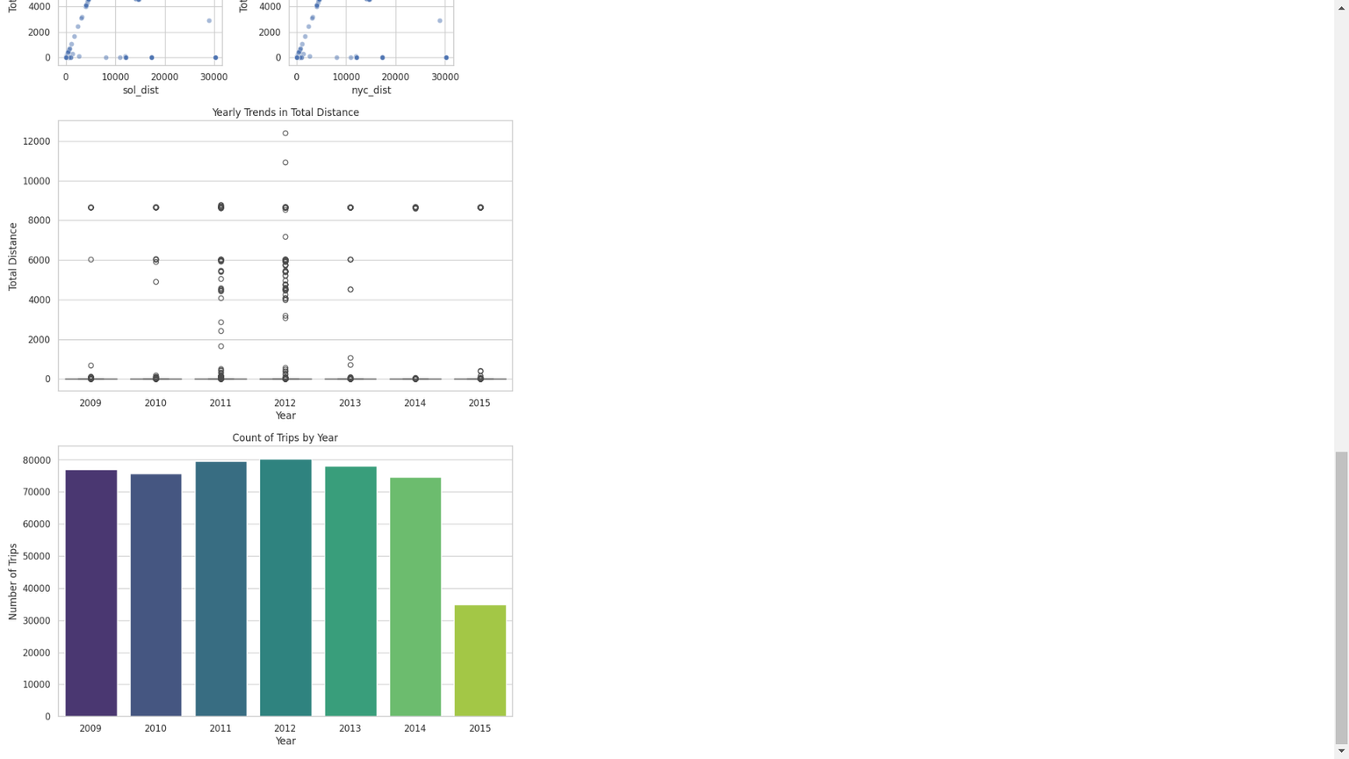


Fare
Back to Agenda Page

Slide 9
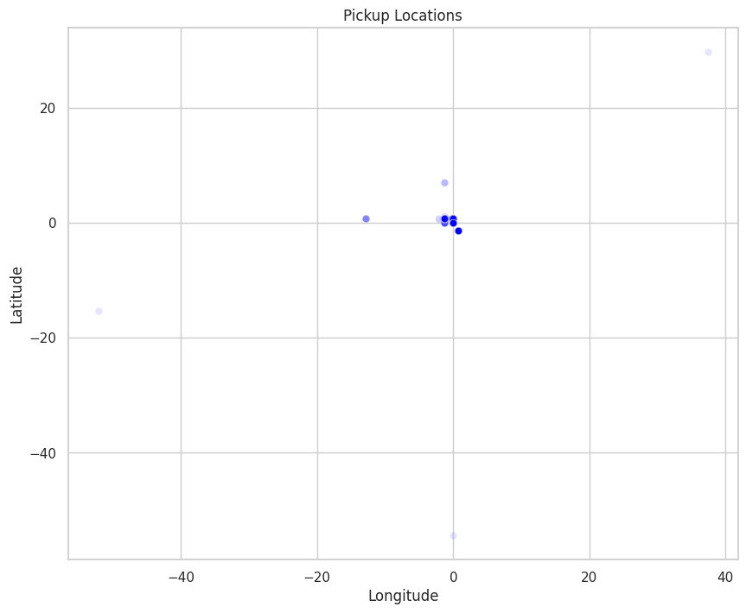


Pickup and Dropoff Locations
pickup and drop of locations are almost in the same place showing that this ride sharing is for a specific institution

Slide 10

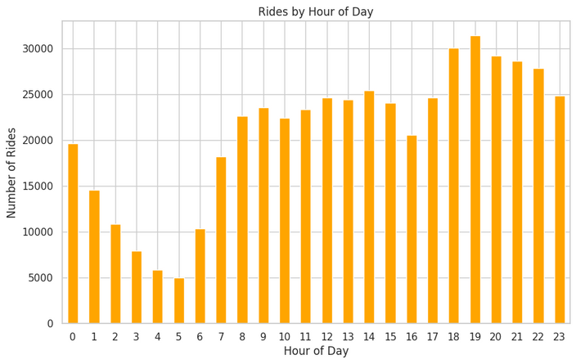
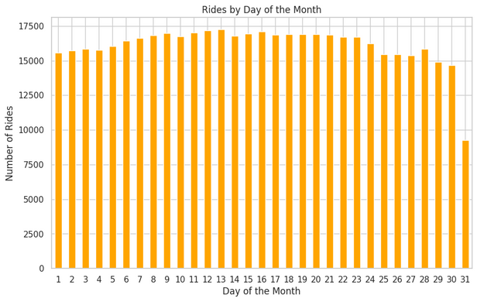
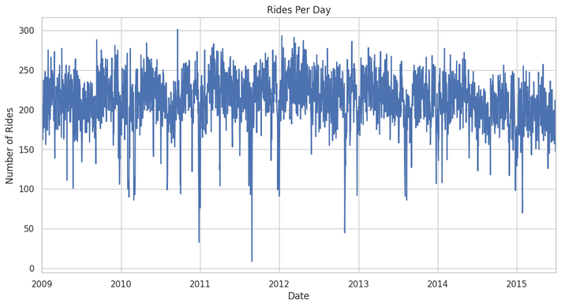

Rides per day ,hour, month
Back to Agenda Page

Slide 11





Key Takeaways
Most rides are affordable
with fare amounts clustered between $6 and $20.
Longer trips generally cost more
but outliers suggest other factors (like promotions or traffic) play a role.
Bad weather and heavy traffic increase fares
making trips more expensive.
Fares fluctuate based on time
higher prices during weekends and busy months.

Slide 12




Recommendations for Further Analysis
Analyze Discounts and Promotions
Investigate if outliers (short trips with high fares) are due to promotions.
Study Driver Performance
Look into how car condition and driver experience affect trip duration and fare.
Demand vs. Fare Relationship
Examine how demand patterns impact surge pricing.
Back to Agenda Page

Slide 13

Conclusion
This exploratory data analysis provides valuable insights into the key factors affecting fare amounts in ride-sharing services.
Understanding these patterns can help both customers and companies optimize their experience and pricing strategies
Thank you!

